Slide 1
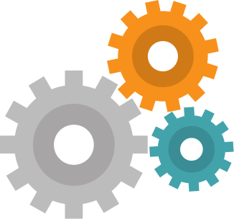
What is Machine Learning?

Slide 2

CONTENT
Introduction to Machine Learning
How does ML work?
Types of Machine Learning
Data warehouse
Data mining
Uses and Importance of Machine Learning

Slide 3
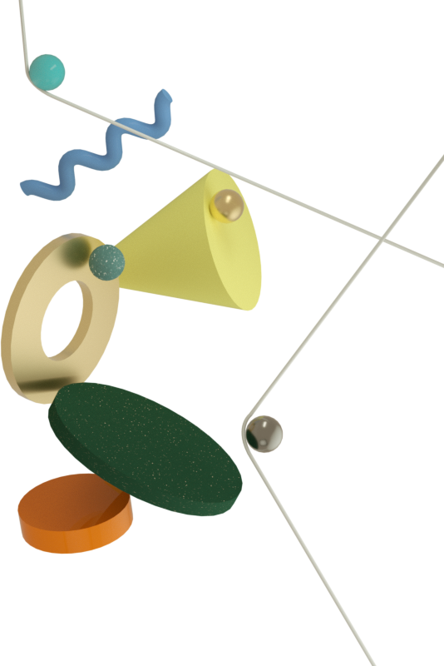
Machine Learning

Slide 4
What is Machine Learning?
01
It is a core sub-area of Artificial Intelligence (AI).
When exposed to new data, these applications learn, grow, change, and develop by themselves.
02
ML applications learn from experience like humans without direct programming.
ML applications learn from previous computations and transactions and use “pattern recognition” to produce reliable and informed results.
03

Slide 5





Machine Learning is all around us in this modern world.
Machine Learning enables computer systems to learn and improve from experience continuously.

Slide 6
While the concept of Machine Learning has been around for a long time , the ability to automate the application of complex mathematical calculations to Big Data has been gaining momentum over the last several years.

Slide 7

Example:

Slide 8

How Does Machine Learning Work?

Slide 9

ML uses computer programs that can access data and perform tasks automatically through predictions and detections.
When you feed a machine with more data, it enables the algorithms that cause it to “learn”.
Algorithm

Slide 10

Types of Machine Learning
02
03
01
Unsupervised Learning
Reinforcement Learning
Supervised Learning

Slide 11


The main process
Training Set
The Machine Learning process starts with inputting training data into the selected algorithm.
The type of training data input does impact the algorithm.
To test whether this algorithm works correctly, new input data is fed into the Machine Learning algorithm. The prediction and results are then checked.
If the prediction is not as expected, the algorithm is re-trained multiple numbers of times until the desired output is found. In this way, the rate of accuracy is increased.
algorithm
sample data set
results

Slide 12

Supervised Learning
In supervised learning, we use known or labeled data for the training data.
Since the data is known, the learning is, therefore, supervised.
Task: Identify Mangoes
The input given to the algorithm is called features and the output is called label
The input data goes through the Machine Learning algorithm and is used to train the model.
Once the model is trained based on the known data, you can use unknown data into the model and get a new response.

Slide 13



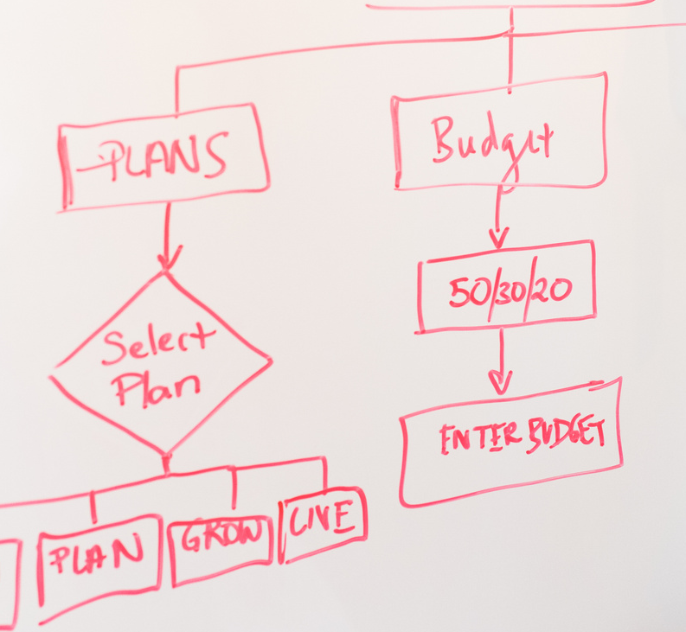


The Process
It's a mango
New Response
Processing
Labelled Data
ML Algorithm
A trained model
In this case, the model tries to figure out whether the data is an mango or another fruit. Once the model has been trained well, it will identify that the data is an mango and give the desired response.
new data set

Slide 14
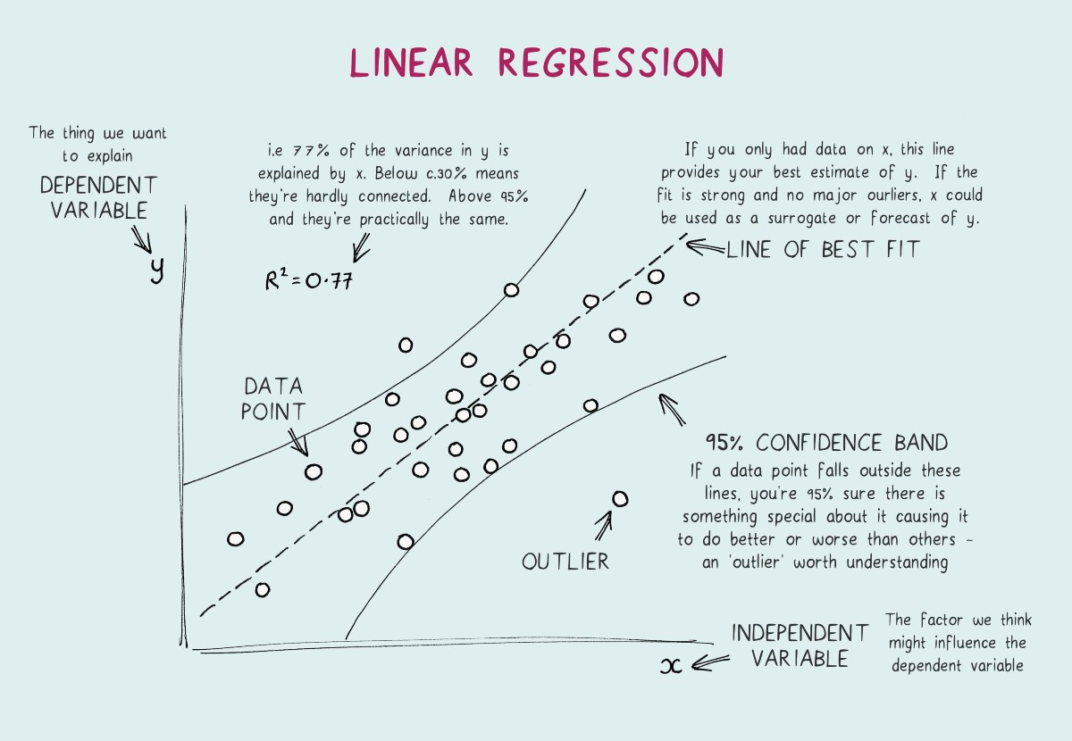
Supervised Learning Algorithms

Slide 15
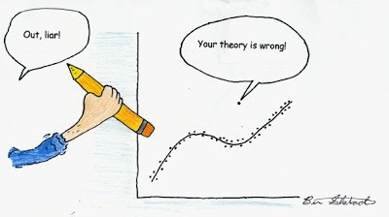
Logistic Regression

Slide 16
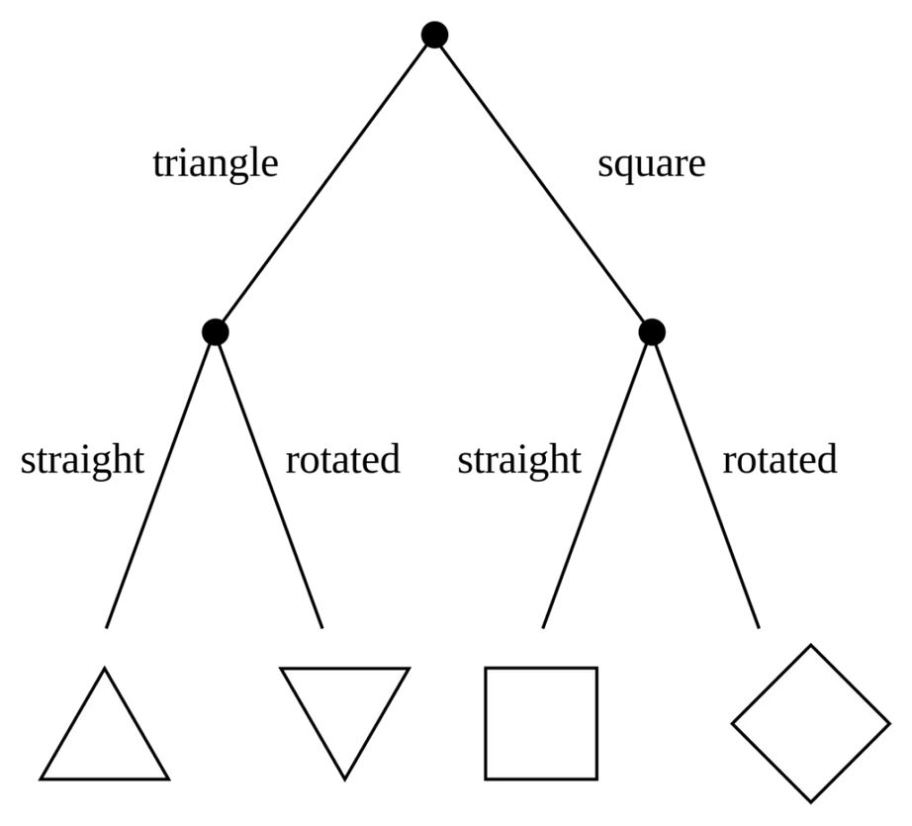
Decision Tree

Slide 17
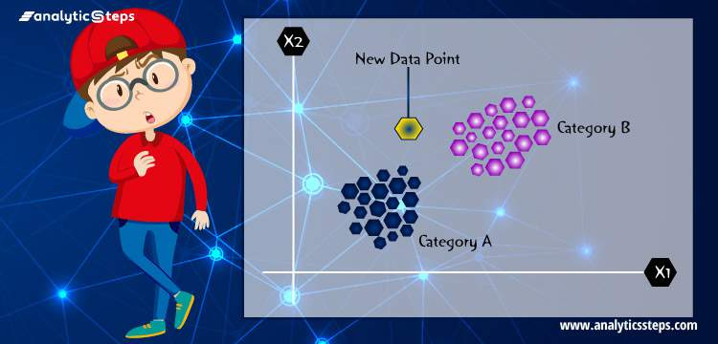
KNN

Slide 18
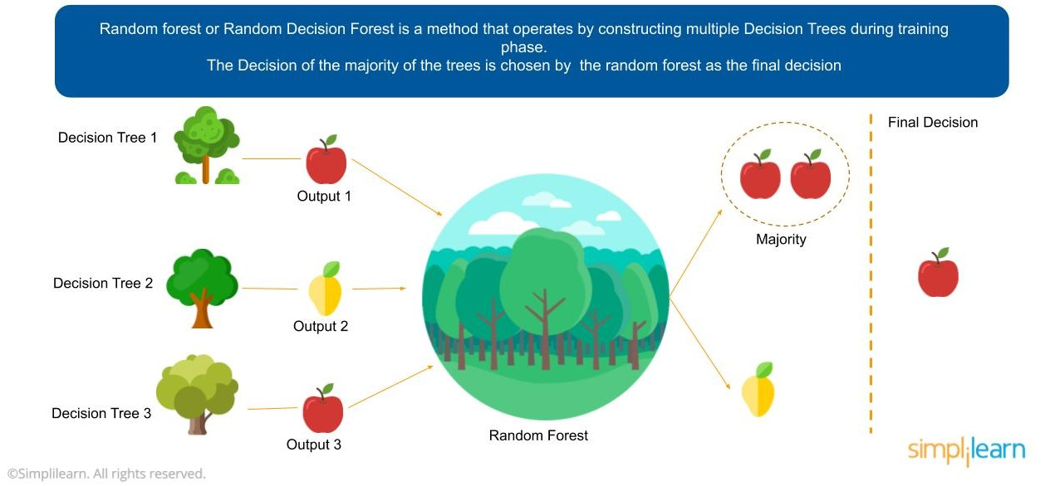
Random Forest

Slide 19
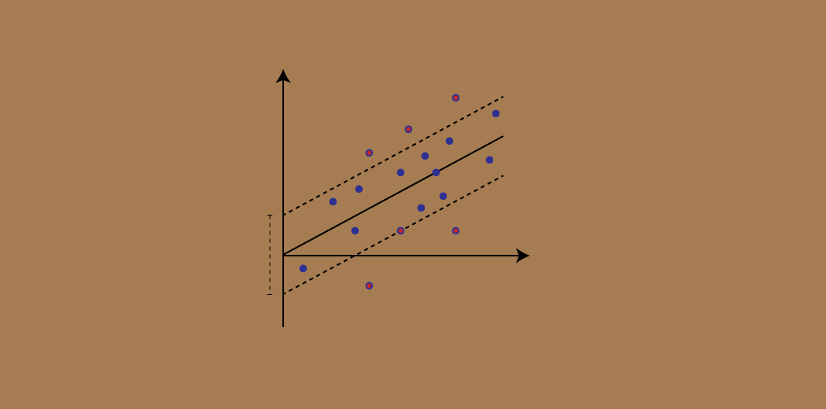
SVM

Slide 20
Unsupervised Learning
In unsupervised learning, the training data is unknown and unlabelled - meaning that no one has looked at the data before.
This data is fed to the Machine Learning algorithm and is used to train the model. The trained model tries to search for a pattern and give the desired response.
In this case, it is often like the algorithm is trying to break code like the Enigma machine but without the human mind directly involved but rather a machine.

Slide 21

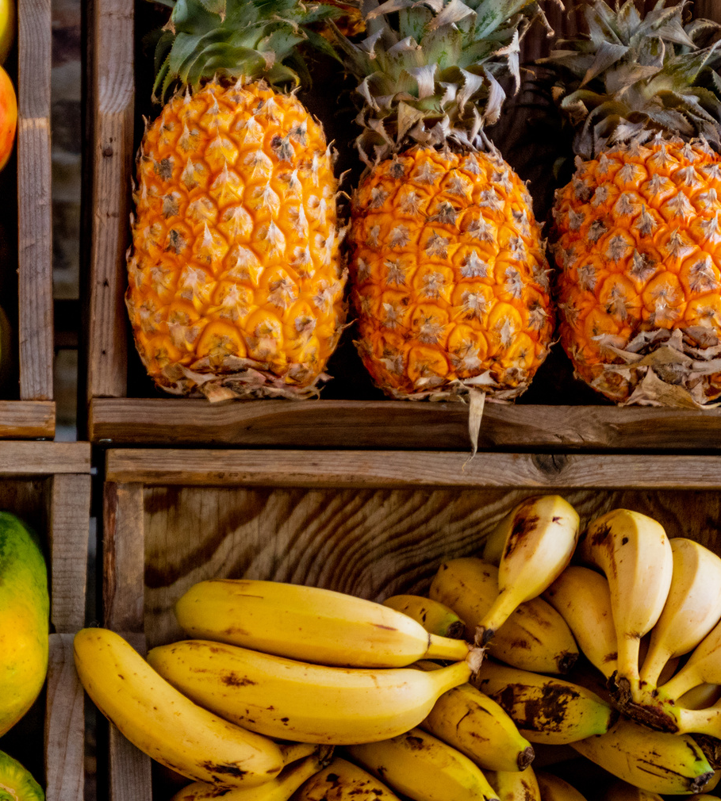
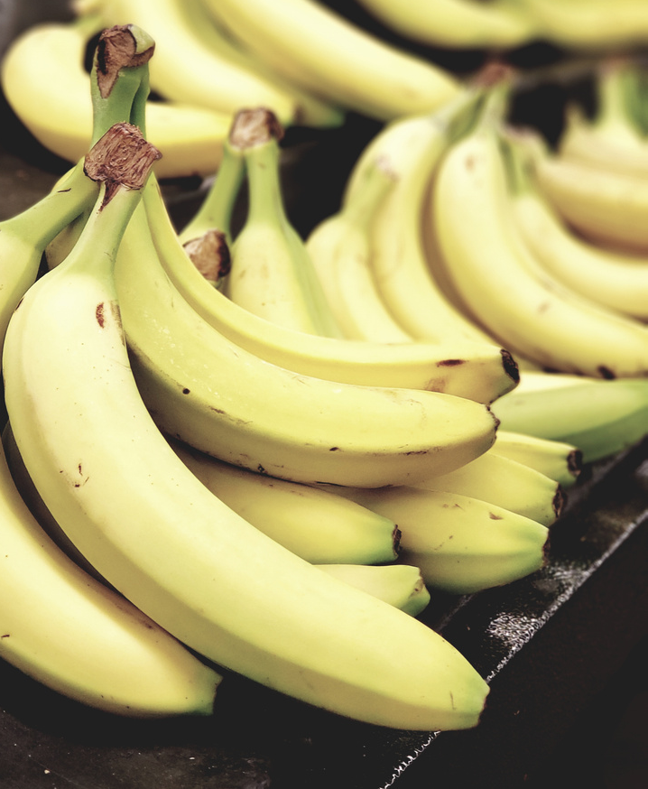
The Process
Processing
Responses
Trained model
Unlabelled Data
ML Algorithm
In this case, the unknown data consists of pineapples and bananas. The trained model tries to put them all together so that you get the same things in similar groups.

Slide 22

Clustering Algorithm

Slide 23
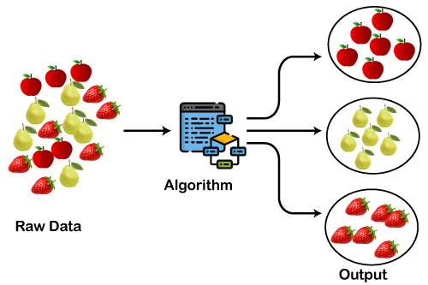

Slide 24
Reinforcement Learning
Like traditional types of data analysis, here, the algorithm discovers data through a process of trial and error and then decides what action results in higher rewards.
Three major components make up reinforcement learning: the agent, the environment, and the actions.
The agent is the learner or decision-maker, the environment includes everything that the agent interacts with, and the actions are what the agent does.

Slide 25
Data Warehouse
A data warehouse, or enterprise data warehouse (EDW), is a system that aggregates data from different sources into a single, central, consistent data store to support data analysis, data mining, artificial intelligence (AI), and machine learning.

Slide 26
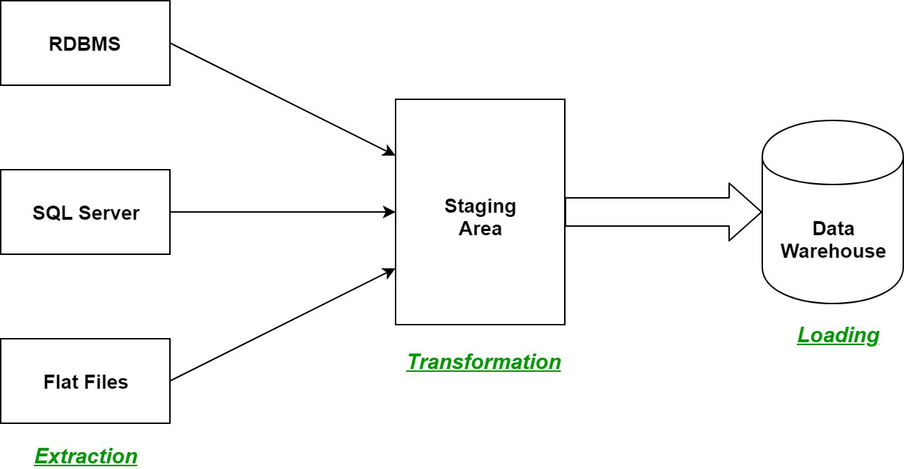

Slide 27
Data Mining
Data Mining is the method of extraction of data or previously unknown data patterns from huge sets of data.
Data Mining utilizes more data to obtain helpful information, and that specific data will help to predict some future results. For example, In a marketing company that utilizes last year's data to predict the sale, but machine learning does not depend much on data. It uses algorithms. Many transportation companies such as OLA, UBER machine learning techniques to calculate ETA (Estimated Time of Arrival) for rides is based on this technique.

Slide 28
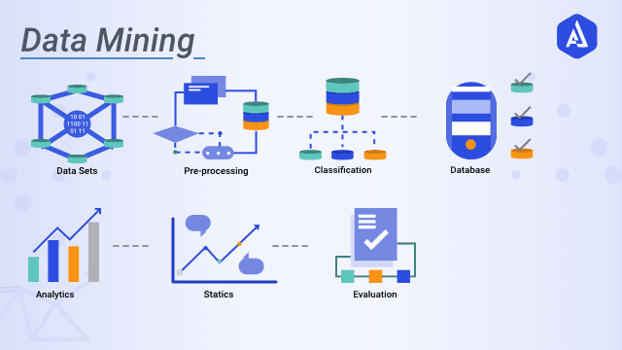

Slide 29

Why is ML important?
What are it's uses?

Slide 30

USES OF ML
To better understand the uses of Machine Learning, consider some instances where Machine Learning is applied: the self-driving Google car; cyber fraud detection; and, online recommendation engines.
Typical results applications we either see or don’t regularly include web search results, real-time ads on web pages and mobile devices, email spam filtering, network intrusion detection, and pattern and image recognition.

Slide 31

ML in Healthcare
Machine learning algorithms can detect patterns associated with diseases and health conditions by studying thousands of healthcare records and other patient data.
Recent developments in machine learning can help increase healthcare access in developing countries and innovate cancer diagnosis and treatment.

Slide 32
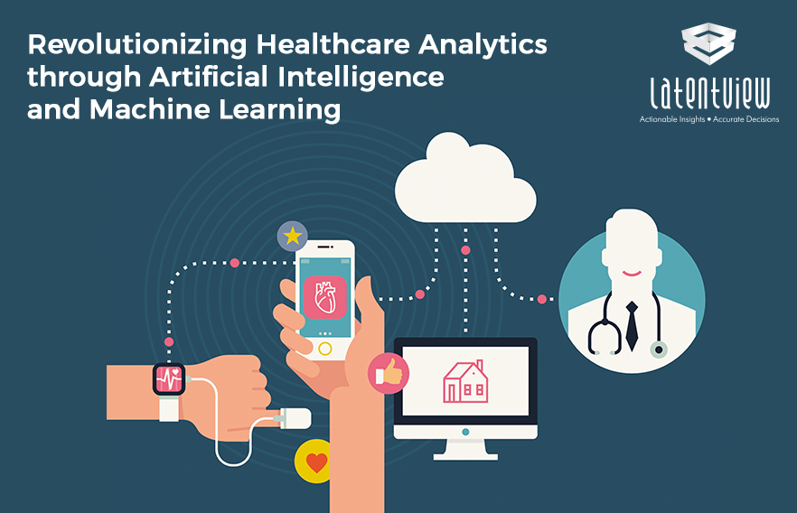

Slide 33
ML in Telecom
With ML in telecom, companies can focus on how they can change their strategies based on the algorithms provided to the machine.
Another method of improving customer experience and ensuring customer retention is by focusing on reducing the time taken to fix the broken towers and the amount of time for which consumers have to be without the services.
Traditional methods of fixing sleeping cells and towers are by physically locating the same. With the help of machine learning in telecom, these towers can communicate with the control room about possible failure.

Slide 34
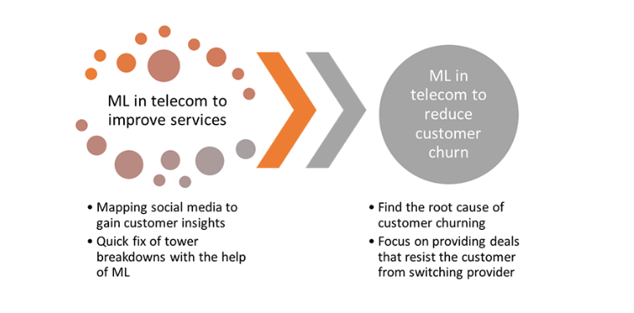

Slide 35
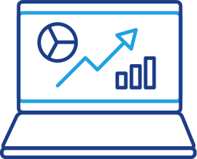


Thank you!

